Slide 1
Columbus quest
An Interactive Ocean Exploration Game

Slide 2
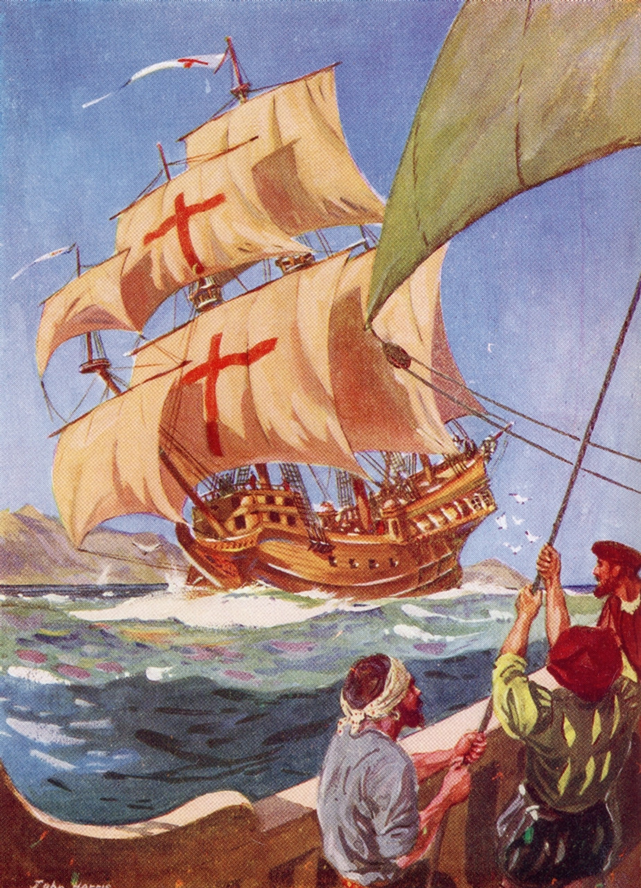
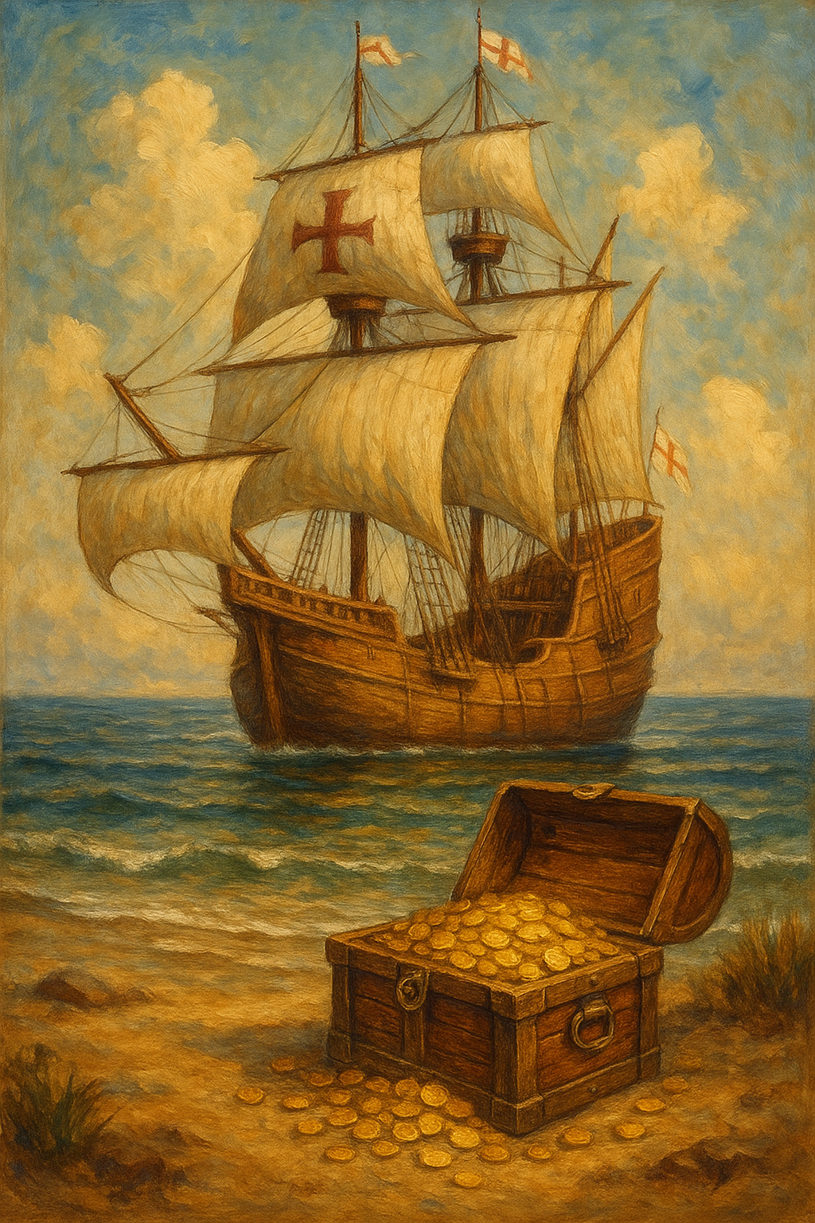
Contents
Game Overview
Requirements
Technologies Used
UML Diagrams
Design Patterns Used
Testing
Team Contribution
Functionality
Future Scope

Slide 3
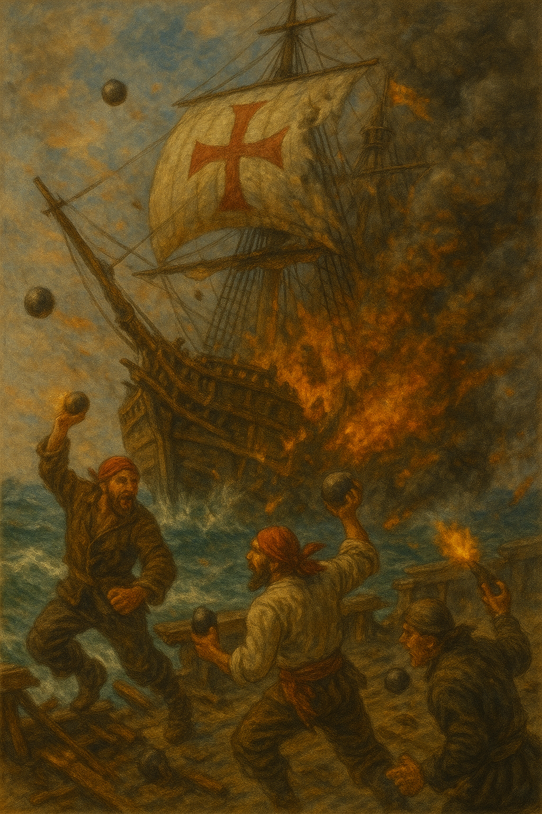
Game overview
Inspired by Christopher Columbus’s
1492 voyage across the Atlantic
Objective: Navigate Columbus’s ship to find the treasure
Gameplay: Move on a grid; pirates chase the player
Hazards: Monsters
Progression: Score increases as player survives; Four difficulty levels - Easy → Medium → Hard → Difficult
Win Condition: Reach treasure
Lose Condition: Pirate catches player / enter hazard

Slide 4
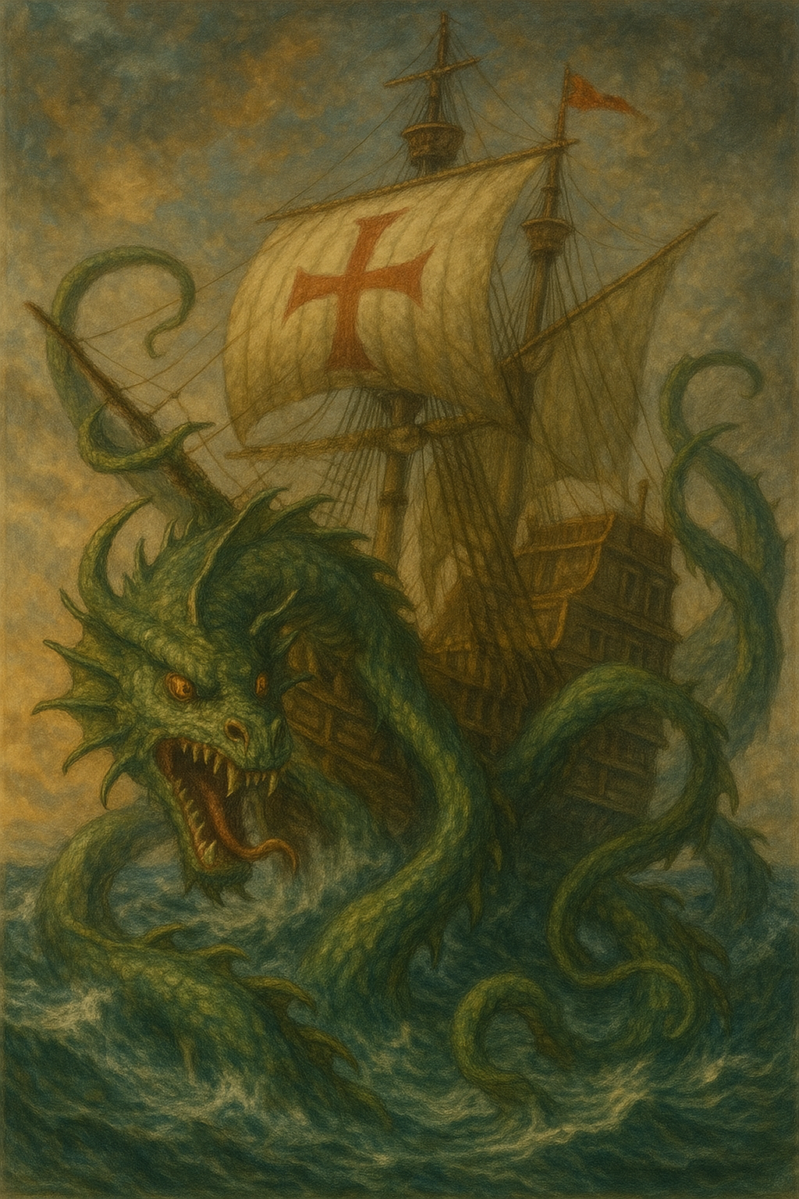
REquirements
Functional
Player can move Columbus’s ship in four directions
Pirates automatically chase the player
Monsters activate and chase Columbus when he enters the treasure zone
Treasure spawns randomly on the map
Level system: Easy → Medium → Hard → Difficult
Lives decrease when Columbus collides with pirates or monsters
Score updates as player progresses
Game detects win (treasure found) and loss (pirate or hazard hit)

Slide 5
Requirements
Non-Functional
Performance: Client requests and server responses should be fast with minimal latency.
Availability: Server should remain accessible while the game is running.
Reusability: Game components should be reusable across levels without rewriting code.
Usability: The UI should be intuitive and responsive for the player.
Scalability: The system should support adding new levels, hazards, or enemies easily.
Consistency: Game state updates should remain accurate across client and server.

Slide 6
Technologies used
Front-end
React
TypeScript
JavaScript
HTML
CSS
Back-end
Java

Slide 7
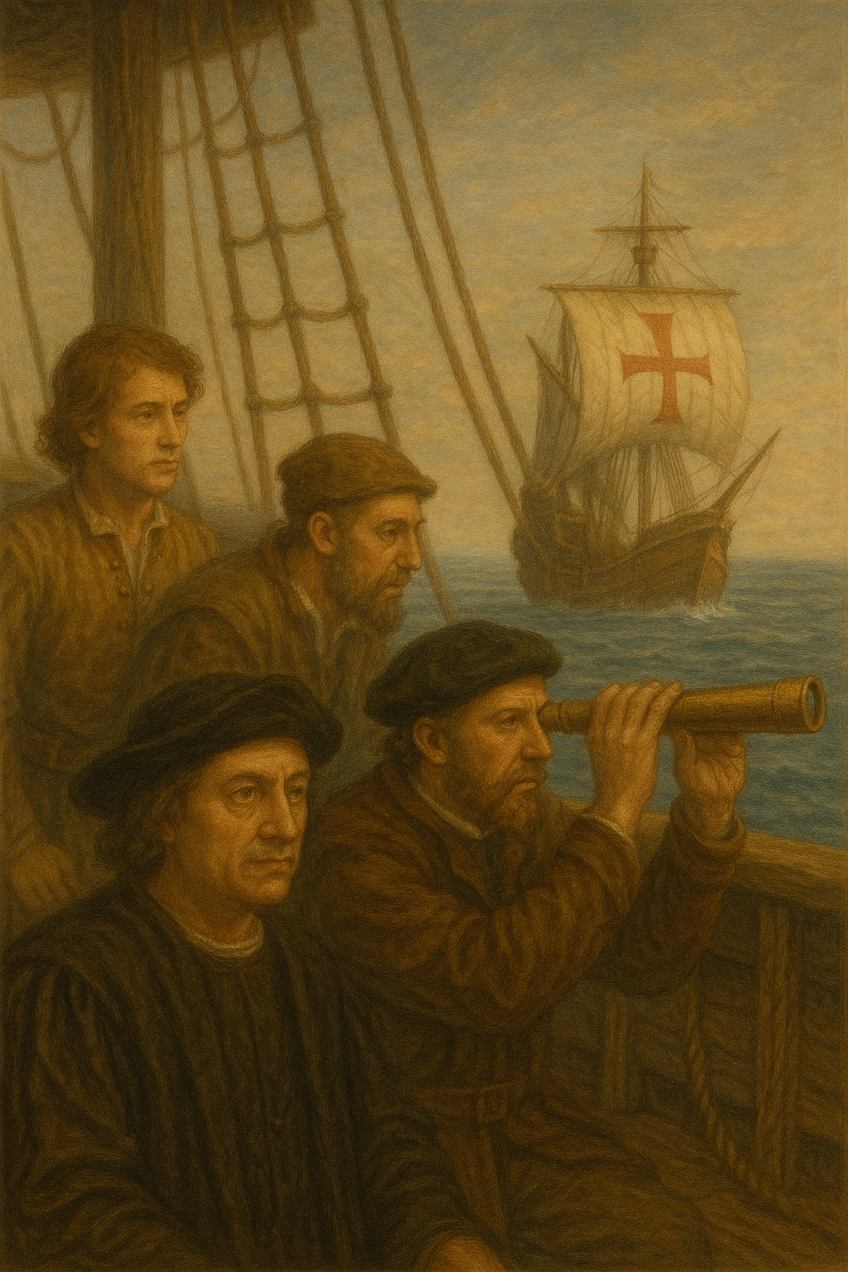
DESIGN PATTERNS USED
Observer
Why It Fits
Keeps pirates automatically synced with Columbus’s position.
Loose coupling between ship and pirates.
Intent: Notify dependent objects automatically when a subject changes.
How We Used It
Ship = Subject
PirateShips = Observers
When Columbus moves, the ship calls notifyObservers().
All pirates receive the updated ship location through update() and then chase accordingly.

Slide 8
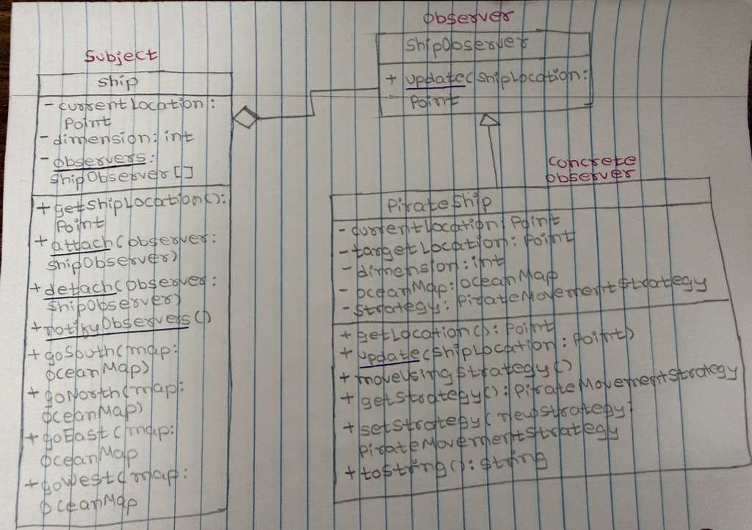
Observer DESIGN PATTERN
Class Diagram

Slide 9
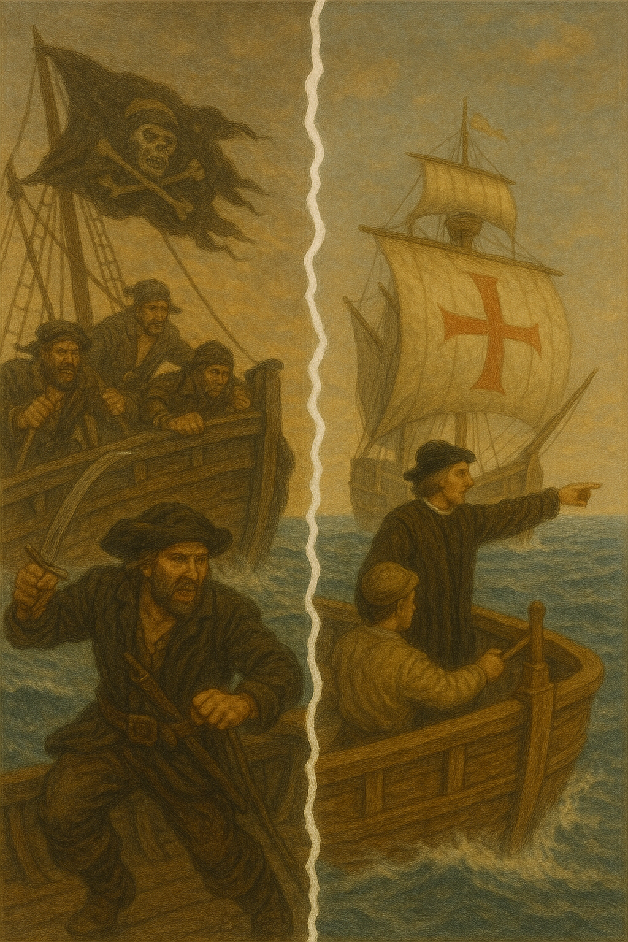
DESIGN PATTERNS USED
Strategy
Why It Fits
You can add new movement styles without changing pirate code.
Behavior is interchangeable at runtime.
Intent: Select an algorithm (behavior) at runtime.
How We Used It
Each pirate has a movement strategy:
ChaseStrategy – aggressively follows Columbus
PatrolStrategy – wanders randomly for every 5 moves of Columbus
RandomWalkStrategy - wanders randomly for every move of Columbus

Slide 10
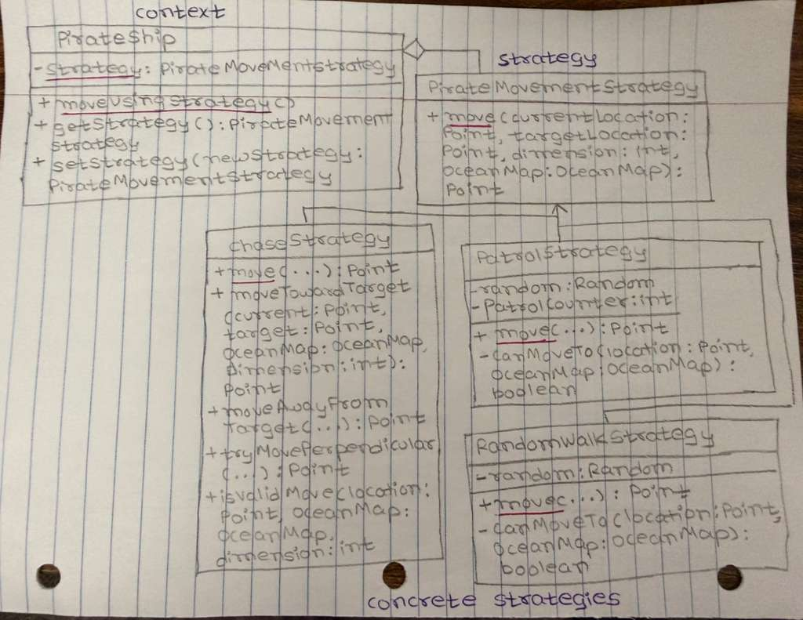
STRATEGY DESIGN PATTERN
Class Diagram

Slide 11
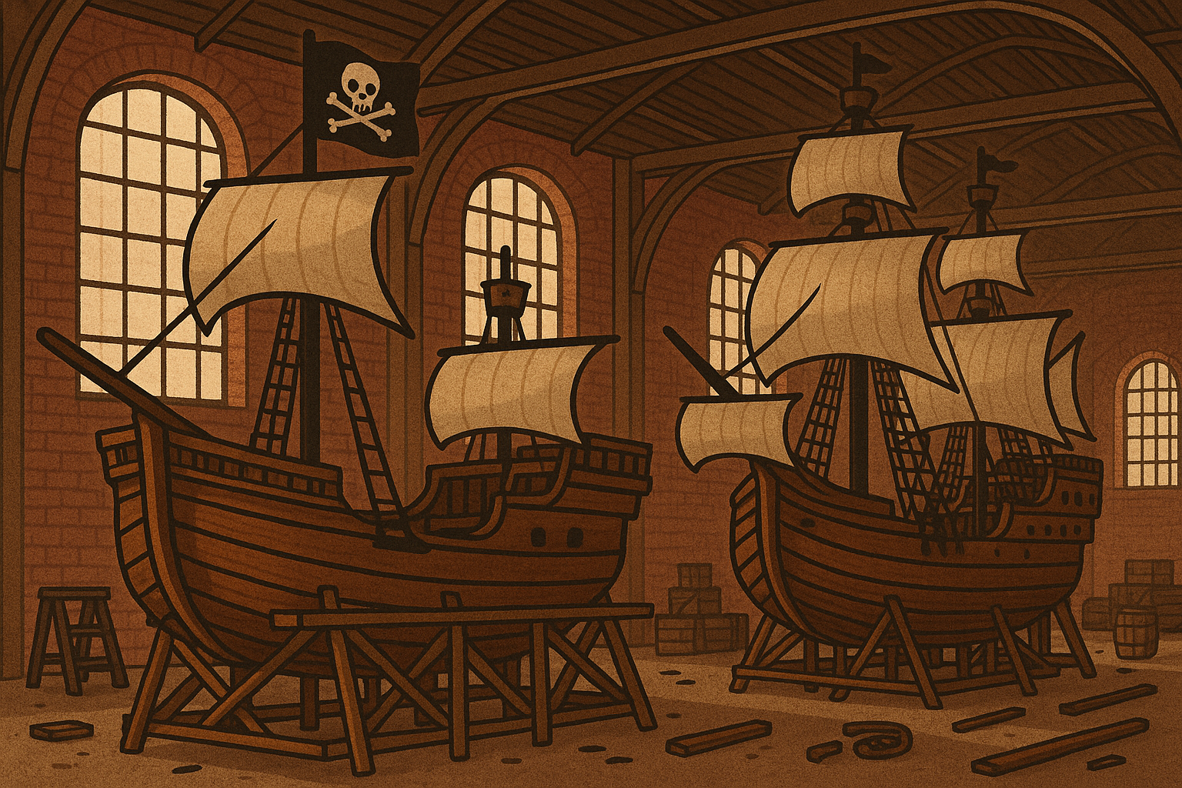
DESIGN PATTERNS USED
Factory
Intent: Create objects without specifying the exact class.
How We Used It
We use PirateShipFactory to create:
Chase Pirates
Patrol Pirates
Random Walk Pirates
Difficulty level determines which factory is used.
Why It Fits
Clean creation of different pirate types.
Easy to add new pirate behaviors later (OC Principle)

Slide 12
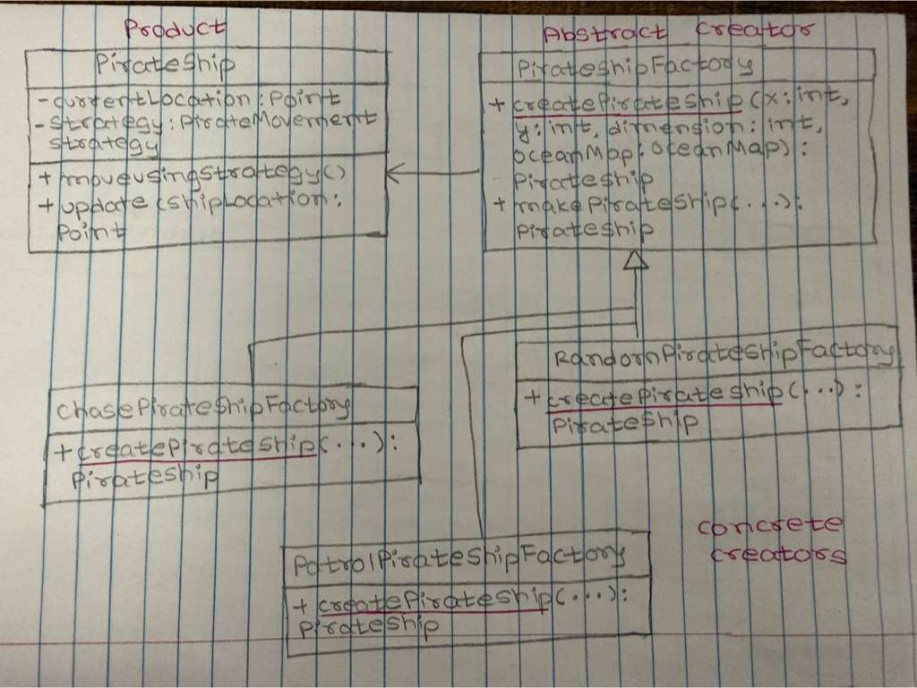
Factory design pattern
Class Diagram

Slide 13
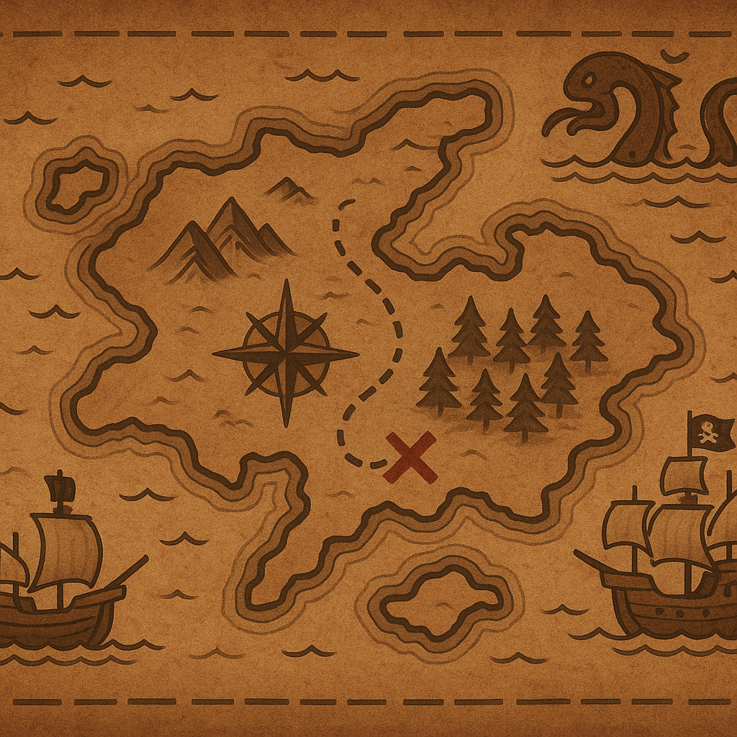
DESIGN PATTERNS USED
Singleton
Intent: Ensure only one instance of a class exists globally.
How We Used It
OceanMap.getInstance() returns the one shared map.
All ships, pirates, monsters use the same map instance for:
grid boundaries
island positions
valid movement checks
Why It Fits
Guarantees consistent game world state.
Prevents multiple conflicting maps.

Slide 14
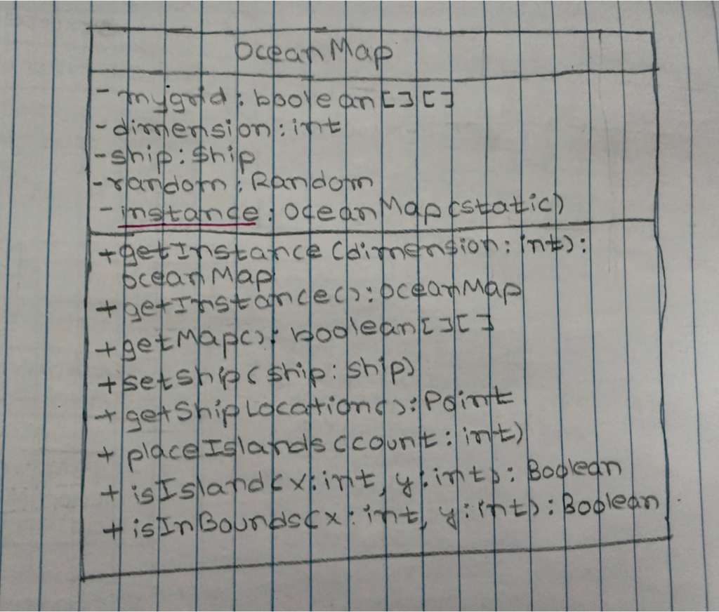
Singleton design pattern
Class Diagram

Slide 15
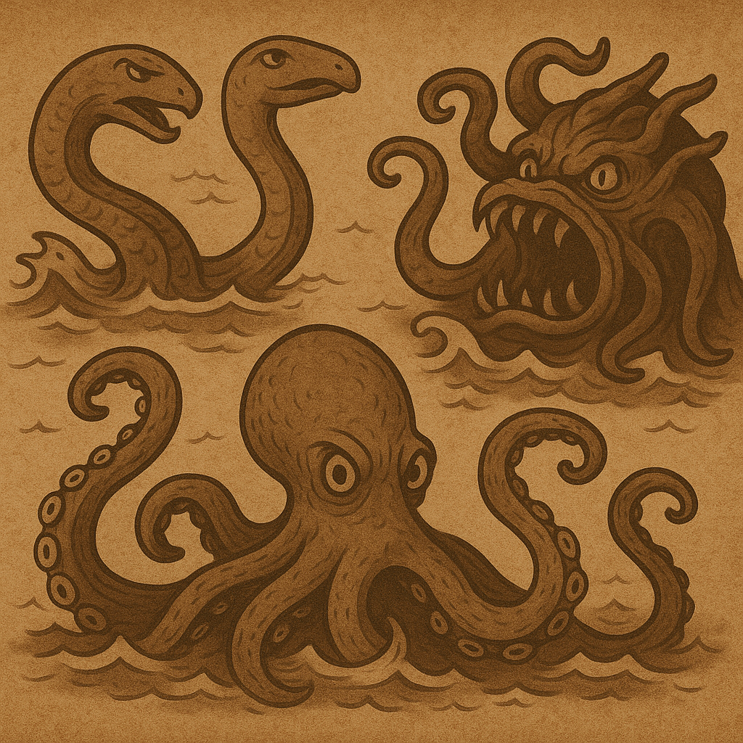
DESIGN PATTERNS USED
Composite
Intent: Treat individual objects and groups uniformly.
How We Used It
SeaMonster = single entity (leaf)
MonsterGroup = composite containing multiple monsters
Both implement the same interface OceanEntity
Game loops call:
entity.move(ship)
entity.collidesWith(...) for both single monsters and groups.
Why It Fits
One interface for both single and grouped monsters.
Clean handling of multi-monster movement.

Slide 16
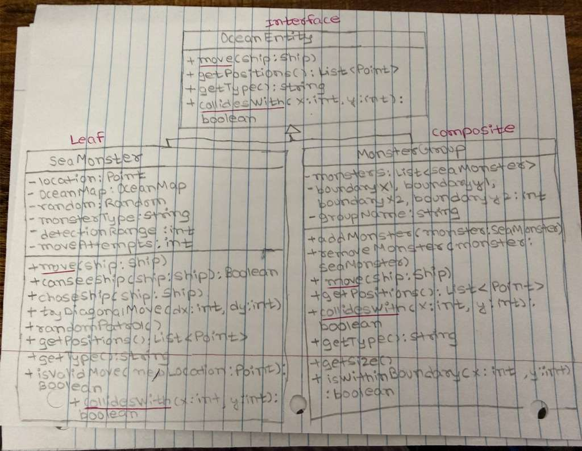
Composite design pattern
Class Diagram

Slide 17
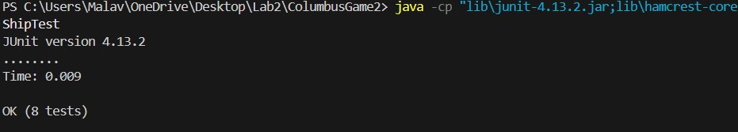
Testing
ShipTest

Slide 18
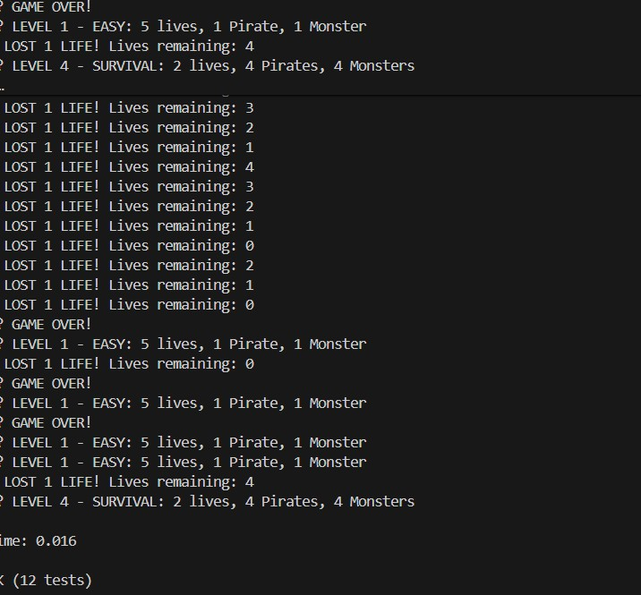
Testing
GameControllertest:-

Slide 19
TEAM CONTRIBUTION
Sailee
Design Patterns (Factory, Singleton & Composite)
UML diagrams
Front-end
Malavika
Design Patterns (Observer & Strategy)
Test Cases
Front-end

Slide 20
FUNCTIONALITY

Slide 21
FUTURE SCOPE
Whirlpool Teleportation Mechanic
Add whirlpools that teleport Columbus or pirates to random positions for more unpredictability.
Power-Ups
Speed boost, temporary invisibility, or shield regeneration.
Multiplayer Mode
Two ships competing for treasure or co-op mode.

